Slide 1
Vehicle Energy Capture
By: Mason Ciari, Trey Gohlmann, Shawn Laikupu, Roman West

Slide 2
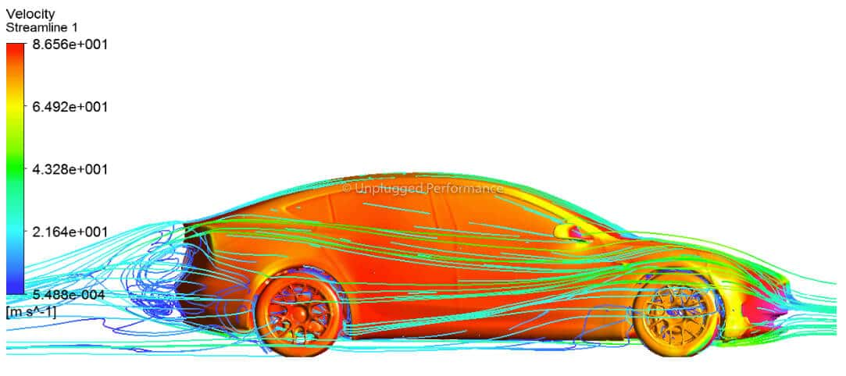
Introduction
Harness energy from turbulent flow around moving vehicles

Slide 3
Background
Every Vehicle Experience Drag
Avg. Drag Coefficient is .4 for modern vehicles
Rear and Front
Turbulent and Laminar
Aerodynamics of the Vehicle
Impacts Factors such as grip, stability, handling, efficiency, etc.

Slide 4
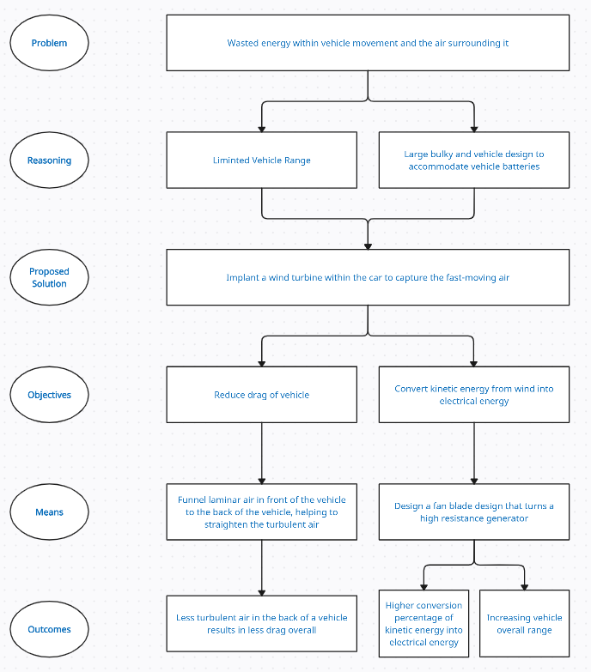
Objective Tree
Problem: Cars waste energy as they move and push through air
Why it matters: This limits how far they can go and makes cars bigger to hold batteries
Solution: Put a wind turbine inside the car to catch fast-moving air
Goals: Make the car use less energy and create extra electricity
How: Guide air smoothly through the car and use a smart fan design
Results: Less air drag, more power made, and longer driving range

Slide 5
Testing Method
Two Parts
Test turbine blades and designs
Test selected turbine system on a moving RC Car

Slide 6
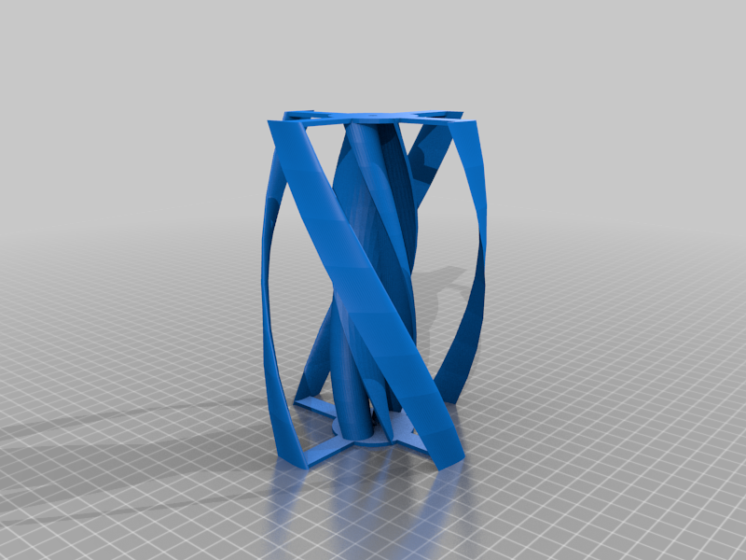

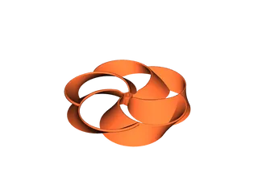
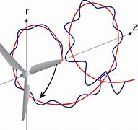
Turbine Background and Designs
Multi-blade turbine
Toroidal turbine
Vertical turbine
Tip vortices

Slide 7
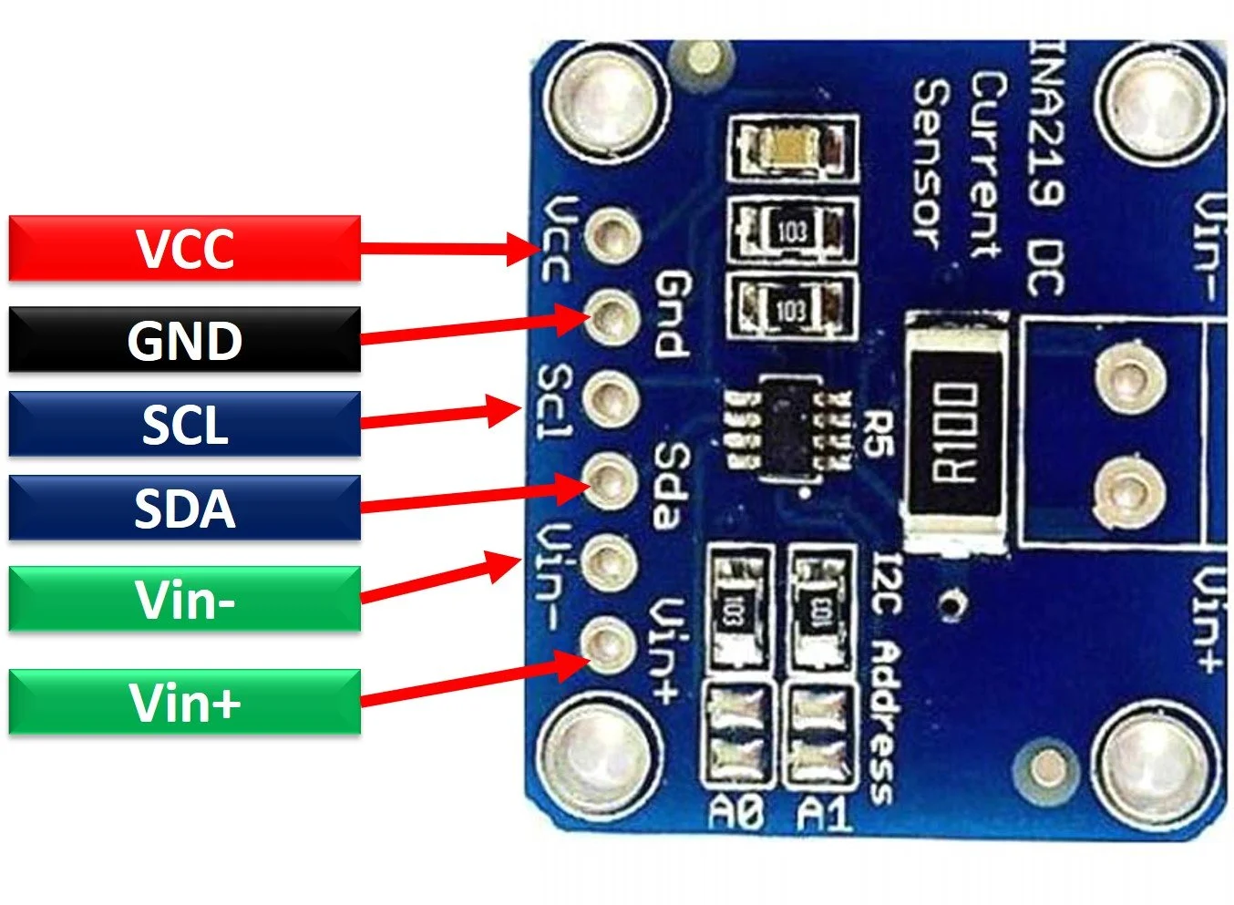
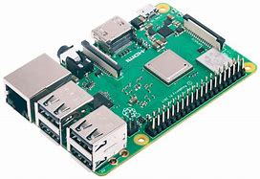
Data Collection Instruments
INA219
Adafruit INA219
Raspberry Pi
Hotspot SSH Capabilities
PiSugar S Plus
Raspberry Pi 3B+

Slide 8
Python Code Aspects
Utilized libraries:
Adafruit_ina219
Openpyxl
Busio/Board
DateTime/Time
OS
I2C bus configuration.
ADC Resolution Configuration (32 samples of 12 bits)
Calibration: match voltage and current from a DC power supply
Repeat for 10 min:
Read sensor data
Write and display sensor data
Pause so the whole process takes 1 sec
Save file, and close

Slide 9
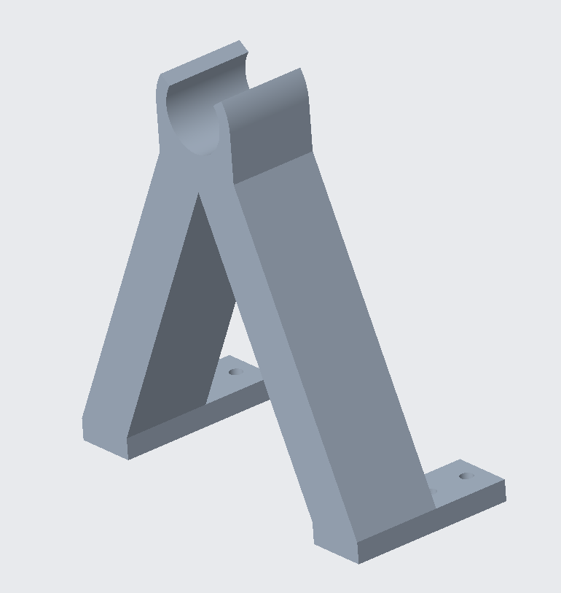

Design Specifications
Final Generator Mount
Toroidal Fan design
Attachable Generator Mount

Slide 10
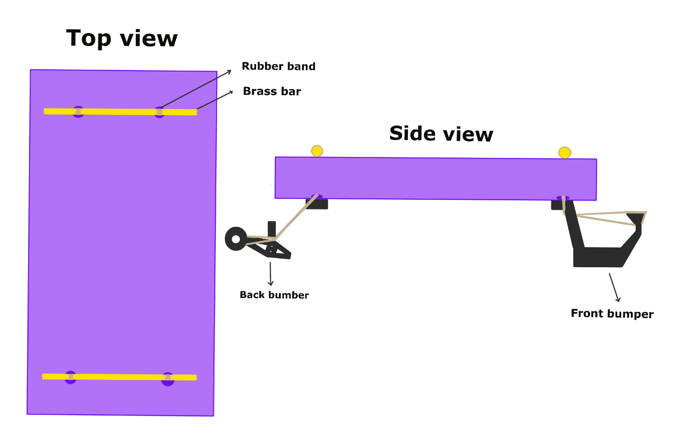
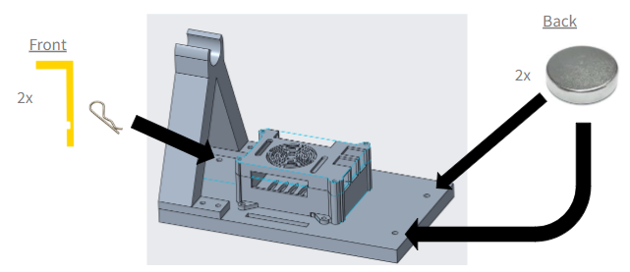
Mounting Specifications
Final Holding Concept
Elastic Holding Concept

Slide 11
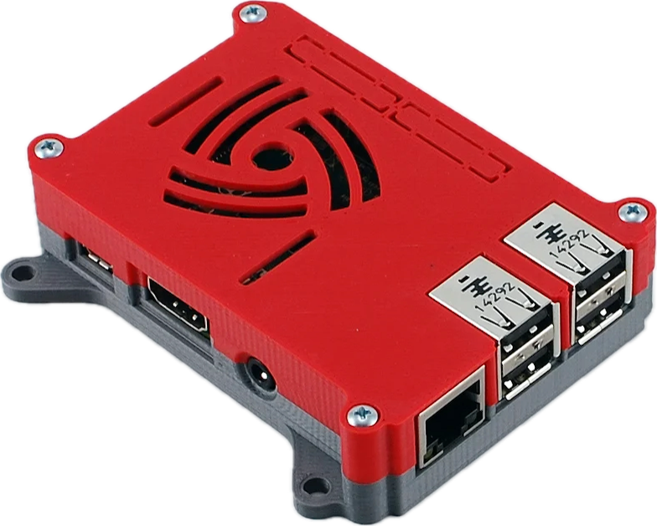
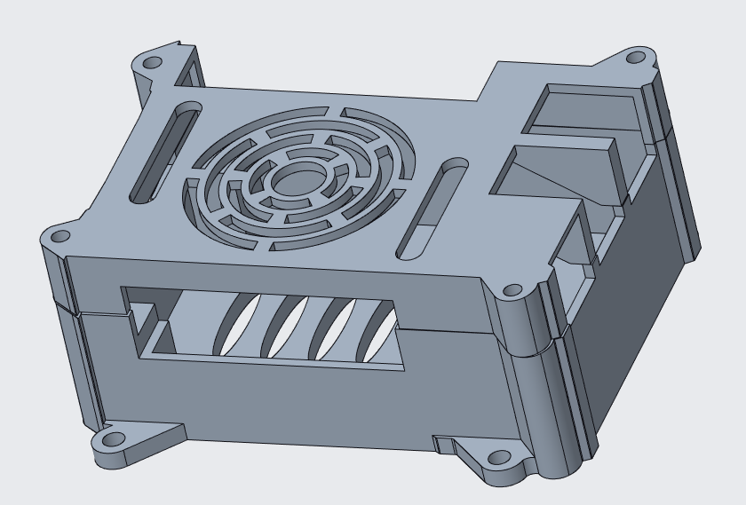
Protective Design Specifications
Original Raspberry Casing
Redesign Raspberry Pi Casing

Slide 12
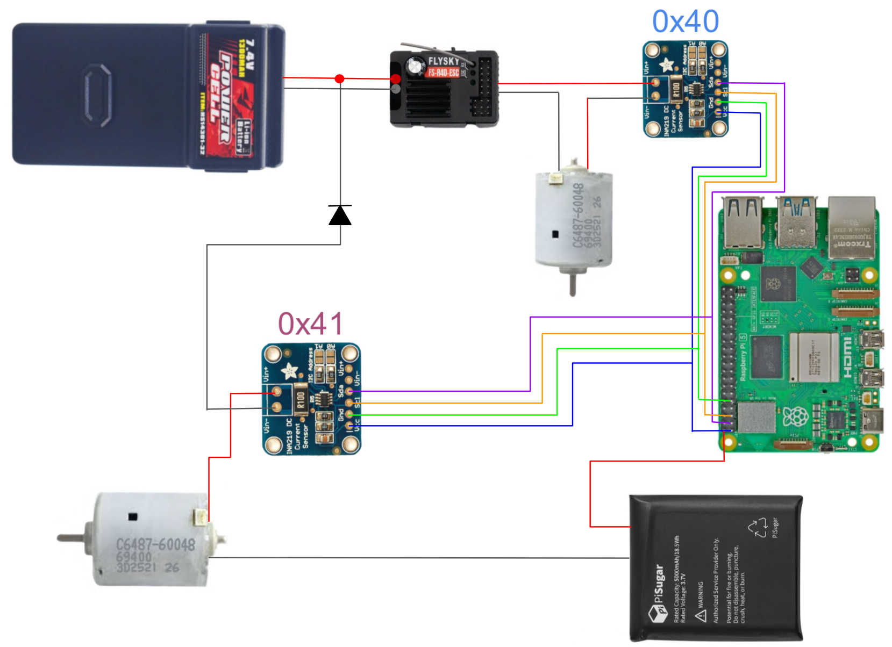
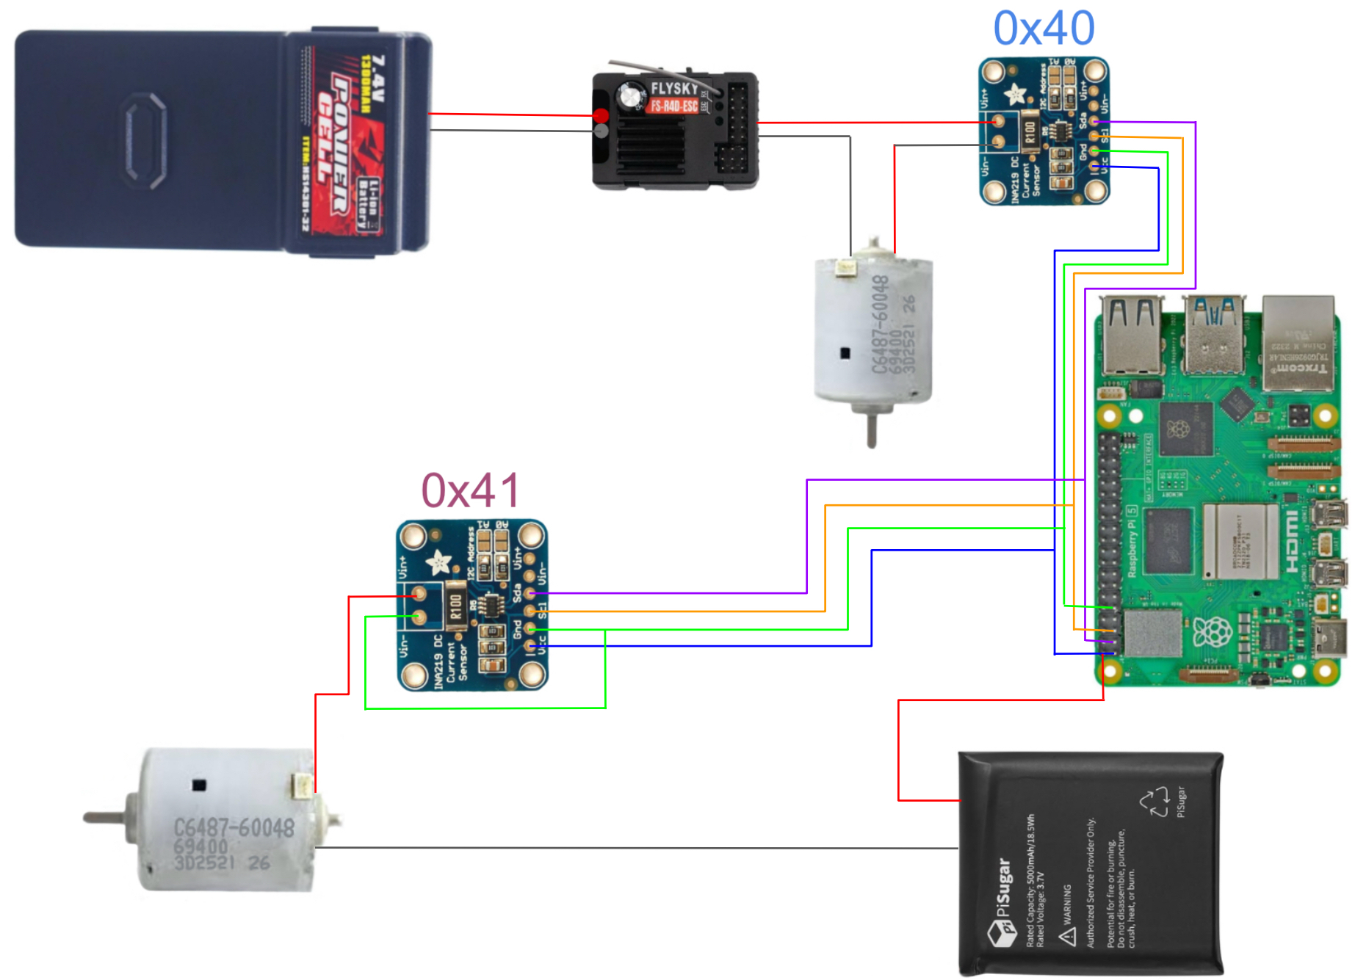
Electrical Specifications
Ideal Electrical Diagram
Physical Testing Electrical Diagram

Slide 13
Design Changes and Challenges
Securing to the Platform
Raspberry Pi Holder
Existing RC Car Structure
Motor Stalling
Resistor blown on INA 219
Testing in Real Conditions

Slide 14
Results: Baseline
Category | Voltage | Amp | Power
Average | 3.1440 | 0.4564 | 1.5775
Standard Deviation | 1.8547 | 0.3843 | 1.6853
95% CI (-) | -0.5653 | -0.3122 | -1.7930
95% CI (+) | 6.8533 | 1.2249 | 4.9481
RC Car without Turbine Assembly, Low Power
Category | Voltage | Amp | Power
Average | 3.0987 | 0.4920 | 1.6021
Standard Deviation | 1.7024 | 0.3842 | 1.6174
95% CI (-) | -0.3061 | -0.2764 | -1.6326
95% CI (+) | 6.5036 | 1.2603 | 4.8369
RC Car without Turbine Assembly, High Power

Slide 15
Results: With Turbine Assembly
Category | RC Voltage | RC Amp | RC Power | Fan Voltage | Fan Amp | Fan Power
Average | 3.4108 | 0.5021 | 1.8136 | 1.0705 | 0.1508 | 0.1619
Standard Dev | 1.8833 | 0.3799 | 1.7416 | 0.3925 | 0.0079 | 0.0606
95% CI (-) | -0.3558 | -0.2577 | -1.6696 | 0.2855 | 0.1350 | 0.0406
95% CI (+) | 7.1775 | 1.2619 | 5.2968 | 1.8555 | 0.1666 | 0.2831
Efficiency (Fan Input/RC Output)= | 8.9253%
Category | RC Voltage | RC Amp | RC Power | Fan Voltage | Fan Amp | Fan Power
Average | 4.1274 | 0.8851 | 3.6504 | 1.9055 | 0.2252 | 0.4262
Standard Dev | 0.6207 | 0.0552 | 0.5847 | 0.6423 | 0.0149 | 0.1334
95% CI (-) | 2.8861 | 0.7746 | 2.4810 | 0.6209 | 0.1953 | 0.1593
95% CI (+) | 5.3688 | 0.9956 | 4.8199 | 3.1901 | 0.2551 | 0.6931
Efficiency (Fan Input/RC Output)= | 11.6752%

Slide 16
Overall Results
3.65 - 1.6 = 2.05 watts, an increase in power due to drag
.43/2.05 = 0.21, 21% returned from the turbine
Consumer Point of View:
3.65 - 0.43 = 3.22
1.6/3.22 = 0.497
Turbine was a successful in capturing energy from turbulent air
Turbine failed to produce enough power for consumer market

Slide 17
Future Improvements
Testing with actual vehicle designs
Electric vehicles
Increase in scale
Testing using realistic conditions
Increase in speed
Natural winds
Difference in terrains

Slide 18
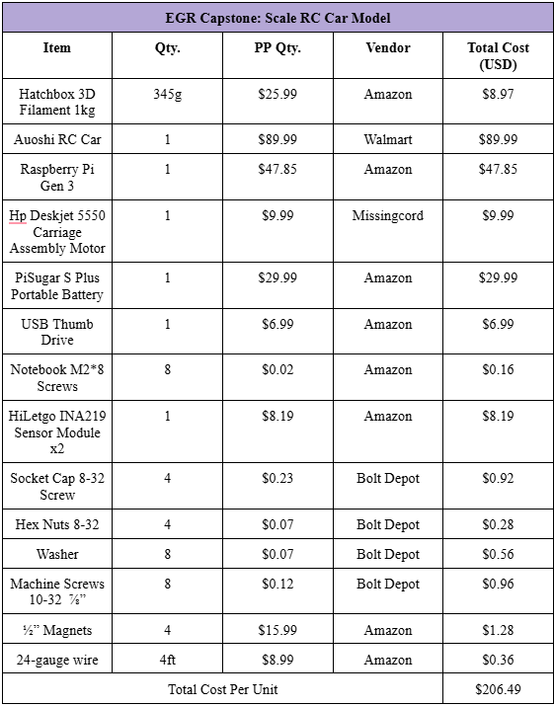
Bill of Materials
Cost Per Unit: $206.49
Initial Budget $500

Slide 19
Questions

